Slide 1
P3 (Prepared, Protected, emPowered): Feasibility and acceptability of a PrEP adherence app featuring peer-to-peer sharing, game-based elements and in-app adherence counseling
tit
ti
Authors: S. Legrand, K. Knudtson, K. Muessig, M. Dixon, A. McGee, J. Dormitzer, R. Jackson E. Adam, L. Hightow-Weidman
Background & Methods
To date, efficacious interventions to promote and sustain PrEP adherence among youth are limited; smartphone apps provide a platform to address adherence barriers
P3, is a theory-based PrEP adherence app for YMSM and YTWSM that includes delivery of in-app adherence counseling
To refine and test P3 we solicited feedback from Youth Advisory Board (YAB) members and conducted usability testing at Adolescent Trials Network for HIV Interventions (ATN) sites associated with the UNC/Emory Center for Innovative Technology (iTech) Across the Care Continuum.
P3 Core Components
Profile Page
Medication Tracker and Adherence Support
Daily Discussion
Brain Builders
Character-Based Narratives
Gamification, Behavioral Economics
story of a group of queer friends navigating coming out, sex, family,
relationships and drama – all while learning how to love themselves, flaws and all.

Slide 2
Results: YAB Feedback
Feedback related to Knowledge Center content:
Use more relevant images in Knowledge Center, ensure tone of articles is appropriate, include additional content that would be useful for target population
Adaptations based on YAB suggestions:
More relevant images added to Knowledge Center categories
Tone of content altered when needed
Additional articles added to address gaps in content
Suggestions for improving Next Step Counseling (NSC) protocol:
  Provide some information about the adherence counselor
  Ability to communicate with adherence counselor between sessions
Adaptations based on YAB suggestions:
  Counselors will provide their first name and introduce themselves during the first session
  Added option to text counselor throughout the day in addition to 30-minute NSC sessions
Notes:
.

Slide 3
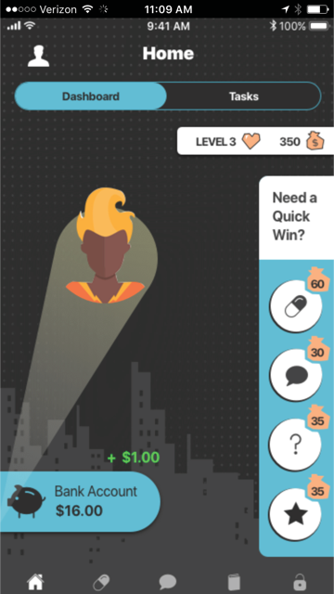
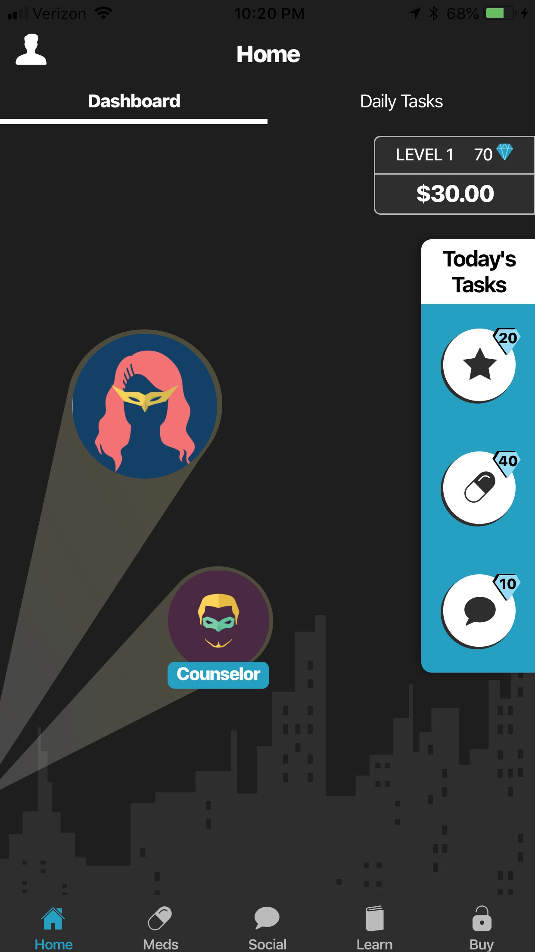
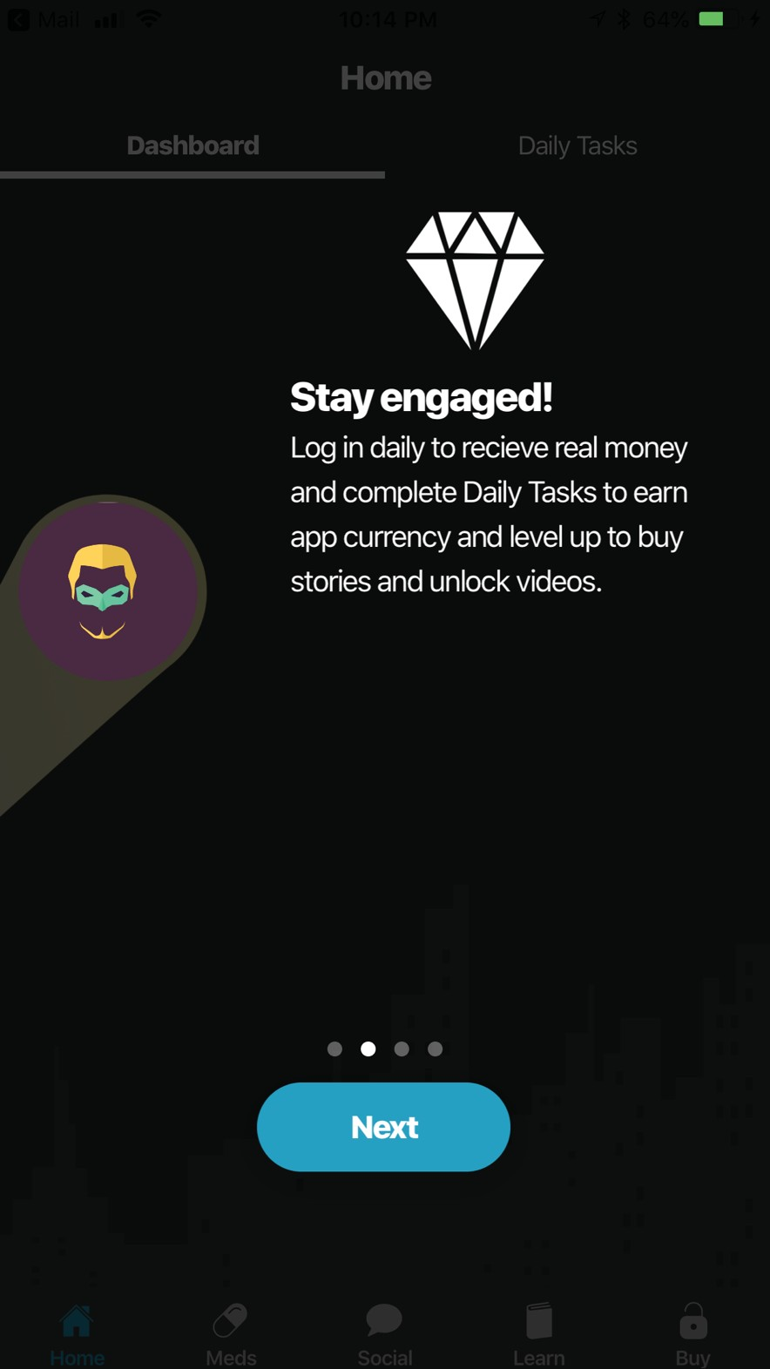
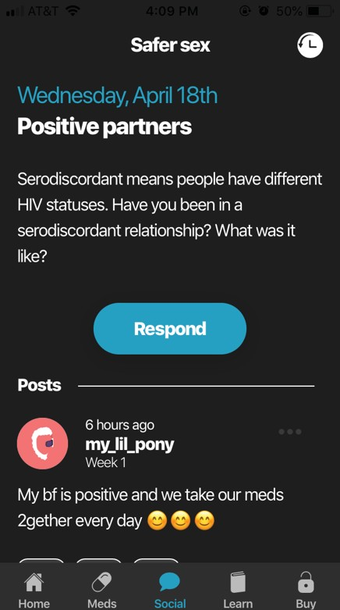






Results: Usability Testing
Participant Feedback and Recommendations
Participant Characteristics
Suggested an avatar for the counselor on the home page
Found home page icons unclear
Were unclear about difference between virtual and real currency
Recommendations for rapport building, session duration and explicitly defining the adherence counselors’ role
Wanted social wall to feel more like Facebook (ability to comment, respond to comments)
Modifications were made to address all of these concerns
12 participants, mean age 21 (17,23)
Most participants (n=11, 92%) found the app highly acceptable
  Favorite features:
    Tailored medication reminders
    Daily medication tracking with corresponding medication history calendar
    Accessibility, comprehensiveness and tone of the information provided
    Ability to connect directly with an adherence counselor
  Mean System Usability Score (SUS) was 75.6
Old Home version
New Home version
New currency guide
New Daily Discussion
This study was funded by the NIH: U19HD089881 (mPIs: Hightow-Weidman and Sullivan; P3 study mPIs: Hightow-Weidman & LeGrand)

